Slide 1
Employee Data Analysis using Excel
STUDENT NAME: Sharmila.R
REGISTER NO: 312220265
DEPARTMENT:III B.com General (Commerce)
COLLEGE: Jeppiaar College of Arts and Science

Slide 2
PROJECT TITLE
Employee Promotion Analysis using Excel

Slide 3


AGENDA
Problem Statement
Project Overview
End Users
Our Solution and Proposition
Dataset Description
Modelling Approach
Results and Discussion
Conclusion
3/21/2024 Annual Review

Slide 4

PROBLEM STATEMENT
To Analyse the Employee Rating for Promotion through Previous year rating in the Employee Promotion Dataset.

Slide 5

PROJECT OVERVIEW
This project aims to analyze the Employee Promotion Dataset to identify patterns and correlations between previous year ratings and promotions. By applying data analysis and machine learning techniques, we will predict the likelihood of promotion based on historical ratings, providing insights for informed decision-making and talent development strategies..

Slide 6

WHO ARE THE END USERS?
Employees
Employees
HR Manager
General Manager
Director
Chairman

Slide 7

OUR SOLUTION AND ITS VALUE PROPOSITION
Conditonal Formatting - To Highlight the Blanks cells and change the colour of the cell .
Sort & Filter - Removing the BlankValues.
Pivot Table - Promotion Analysis from the Company through Previous year rating .
Formulas - IFS (To get the Analysis of Rating )
Graphs- (Bar Chart ) - FINAL REPORT on Employee Promotion.

Slide 8
Dataset Description
Employee Promotion Dataset : Kaggle.com
Features : 36
Department - Text Values
Gender - Text Values
Previous Year Rating - Numerical Values
Analysis of rating - Text Values
Length of Service - Numerical values
is_promoted - Numerical Values

Slide 9

THE "WOW" IN OUR SOLUTION
New Formula Used : IFS
To Find out the Analysis of Rating to check the Promotion Level, by go checking the previous year rating of the employees.
3/21/2024 Annual Review

Slide 10
MODELLING
Dataset Collection - Employee Promotion Dataset
Dataset Preparation - Deleting Blanks, Filtering and Removing Blank data in the Dataset.
Using IFS formula to attain the Analysis of Rating by analysing the previous year rating of the employee (1,2,3,4,5) (High & Less)
Insert Pivot Table to Summarize the Dataset on Employee Performance based on Gender, Previous year rating and Analysis of Rating .
Data Visualization using Bar Chart to represent the Promotion rating of the Employee.
Final Report

Slide 11
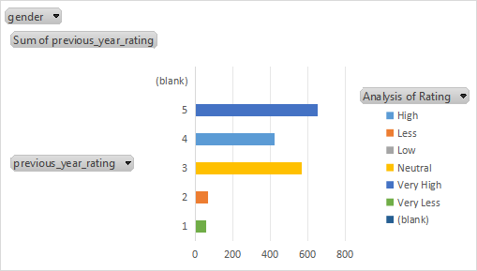
RESULTS

Slide 12
Conclusion
"Employees who did well last year (high ratings) are more likely to get promoted this year. The higher their rating, the more likely they are to move up."
"Employees with high ratings last year are more likely to get promoted. A higher rating boosts promotion chances, helping employers identify top performers and make informed decisions to drive business success and recognize employee achievements."

